Slide 1

东华大学
鲜蔬配送管理系统的设计与开发
我们毕业啦
其实是答辩的标题地方
答辩人
孙芸芸
指导老师
吴国文

Slide 2
研究背景
研究方法
研究成果
论文总结
目录

Slide 3

研究背景

Slide 4
研究背景
研究背景
研究方法
研究结果
问题讨论
论文总结
“
人们追求健康的理念意识正在逐步提升
鲜蔬产品由其产品的特殊性（新鲜、保质期短、产品价格低、物流配送不便等特点），造成其物流配送具有极大地难度。
互联网实现信息化管理的必要性
”

Slide 5
研究内容

Slide 6
研究背景
研究内容
研究方法
研究结果
问题讨论
论文总结
课题设计开发的鲜蔬配送管理系统是一个基于Web应用、系统架构选用方便操作的B/S架构的系统。
系统开发工具及框架：
●IntelliJ IDEA
●spring boot、springMVC、Bootstrap
●MyBatis、Ajax、Javascript
●Maven 项目管理工具

Slide 7
研究背景
研究内容
研究方法
研究结果
问题讨论
论文总结
系统实现功能概述：找到优质鲜疏（品种及基地），通过运输途径环节，把鲜疏送至冷库保鲜，继而配送至客户（电商平台、餐饮及团购）。
该系统目的在于将企业、供应商、客户三者间达到商品信息共享，同时为客户和企业提供一个网上配送一体化的交易平台。
系统包含角色：客户、供应商、采购员、配送司机、 库管员、办公室

Slide 8
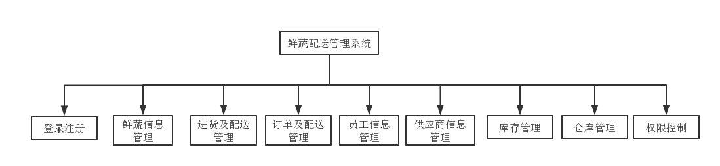
研究背景
研究内容
研究方法
研究结果
问题讨论
论文总结
系统功能模块图

Slide 9
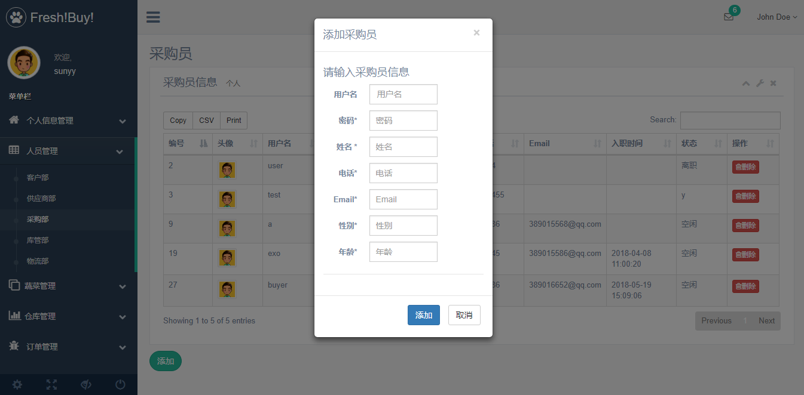
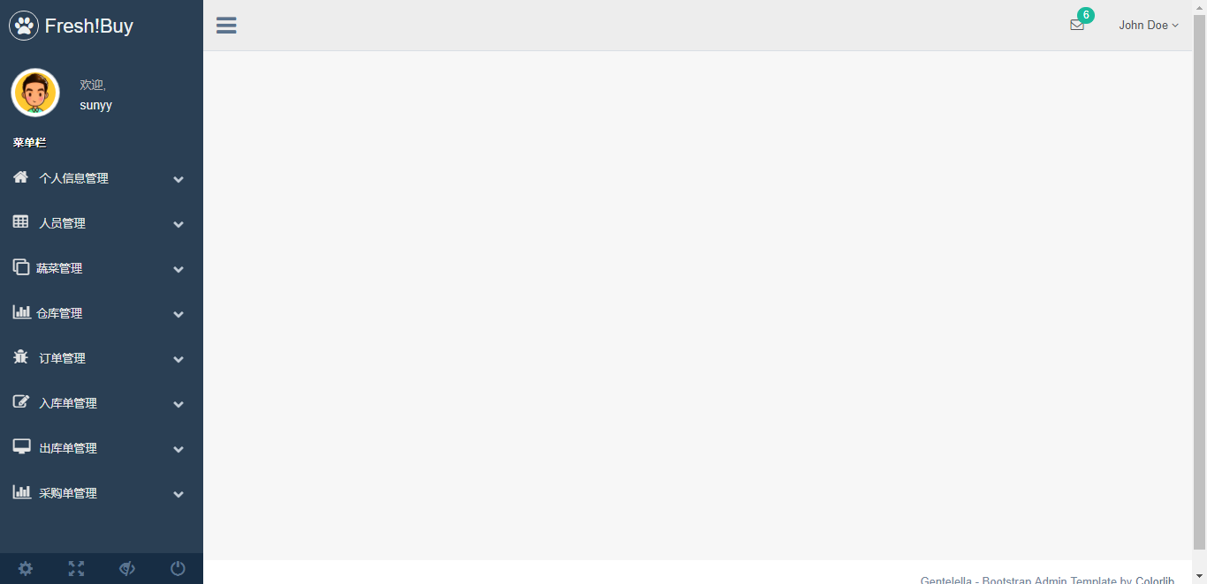
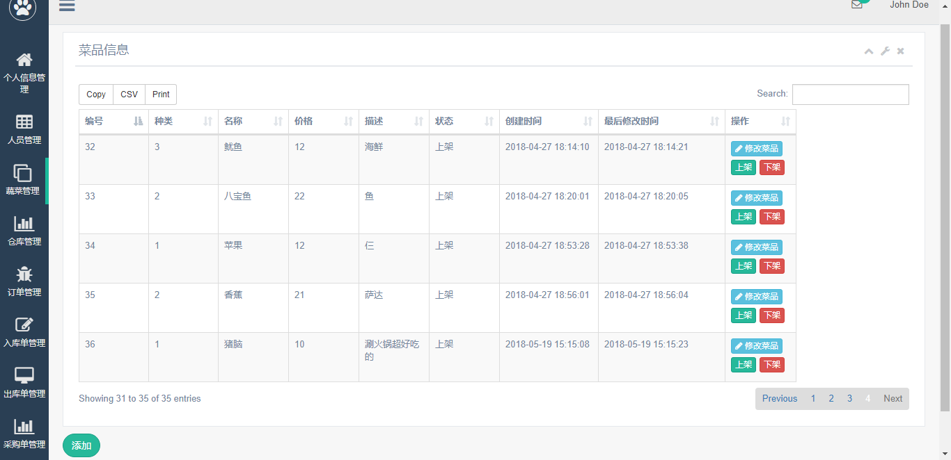
研究背景
研究内容
研究方法
研究结果
问题讨论
论文总结
登录注册
权限控制
登录：不同角色进入不同页面
注册：用户名不可重复
用户不可操作其角色权限以外的功能
防止暴力攻击
鲜蔬信息管理
员工管理
新增、修改鲜蔬、鲜蔬价格管理
鲜蔬上架、下架销售管理
按部门增加员工账户
删除员工，员工原账户无法登录系统

Slide 10
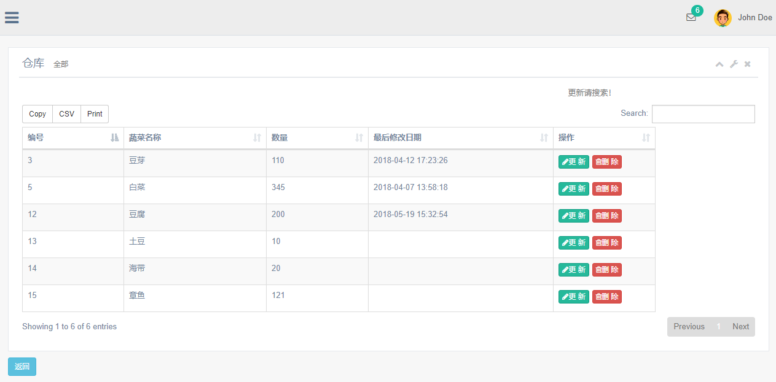
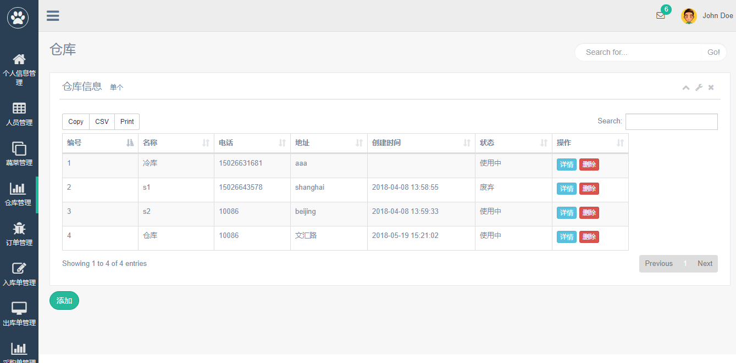
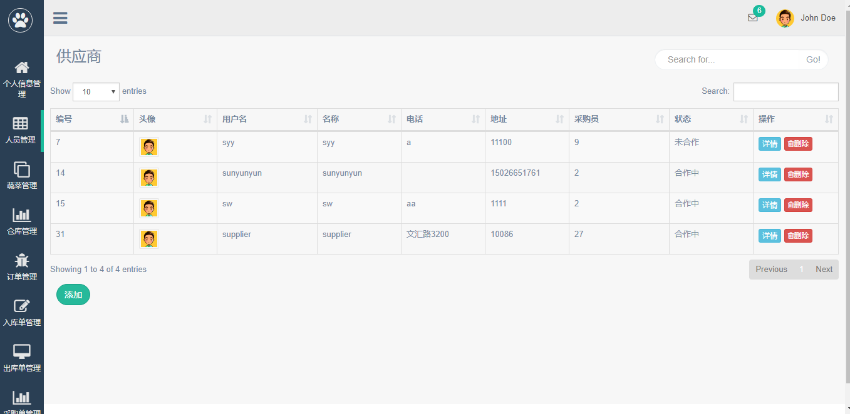
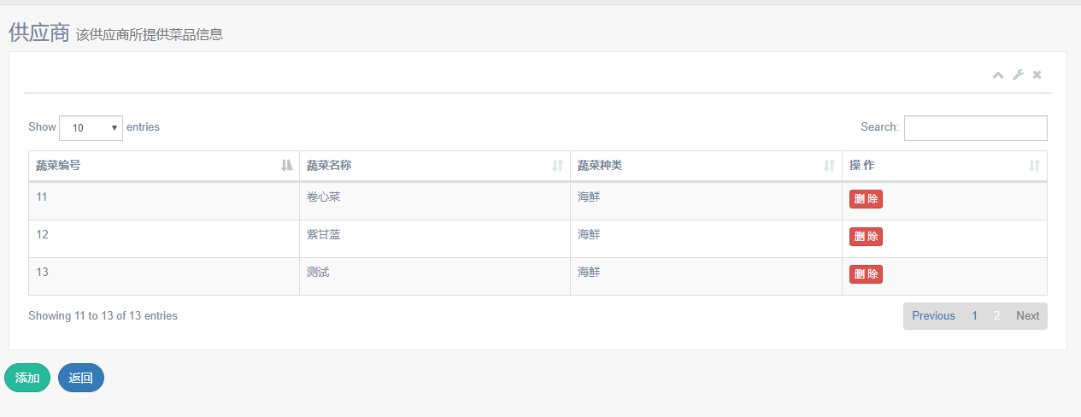
论文绪论
研究背景
研究方法
研究结果
问题讨论
论文总结
供应商管理
仓库管理
新增、删除合作供应商
修改供应商所提供鲜蔬
（采购员、办公室均可）
新增、删除仓库
修改仓库鲜蔬存储量
（库管员、办公室均可）

Slide 11
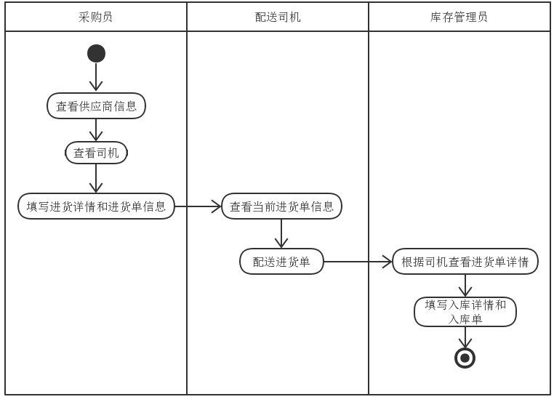
研究背景
研究内容
研究方法
研究结果
问题讨论
论文总结
进货及配送流程

Slide 12
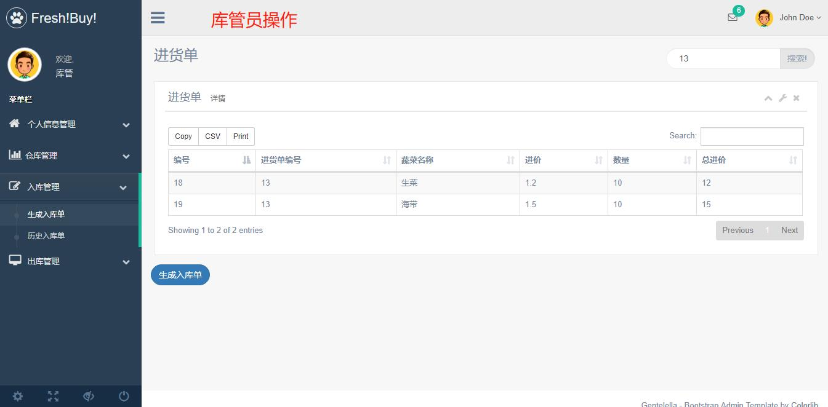
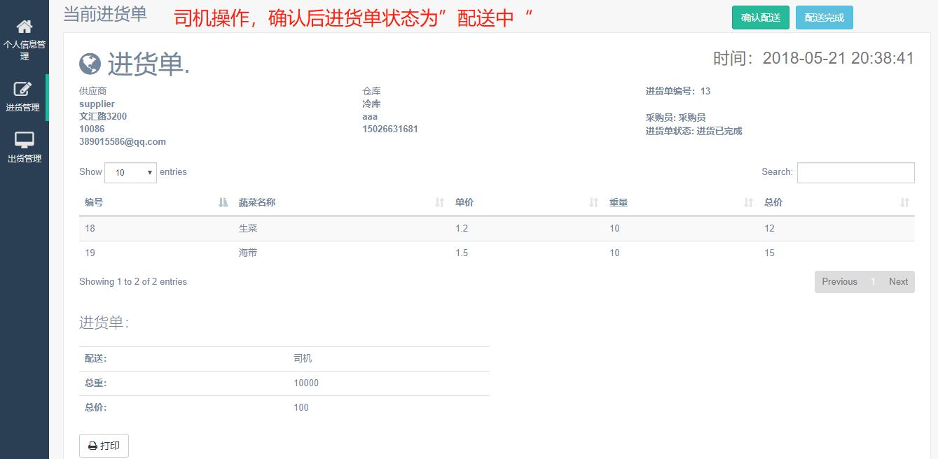
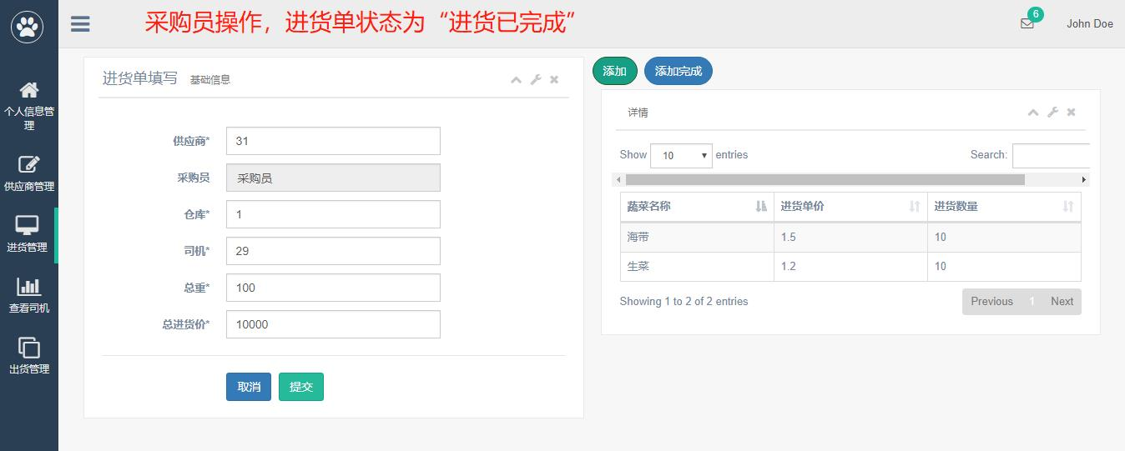
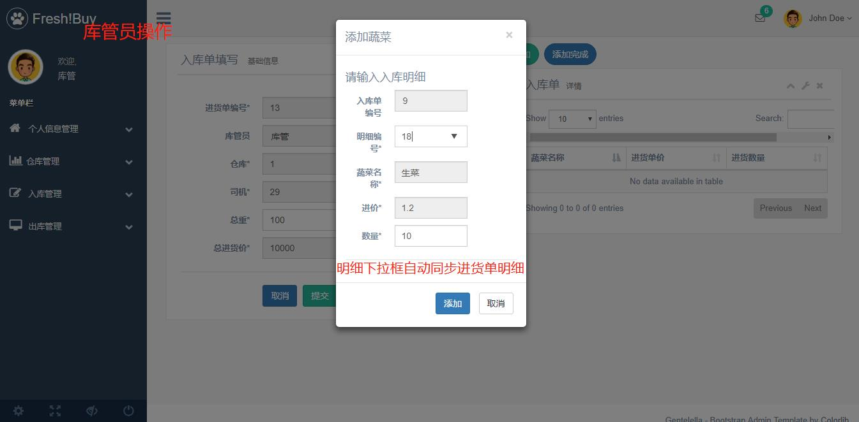
论文绪论
研究背景
研究方法
研究结果
问题讨论
论文总结
进货及配送流程

Slide 13
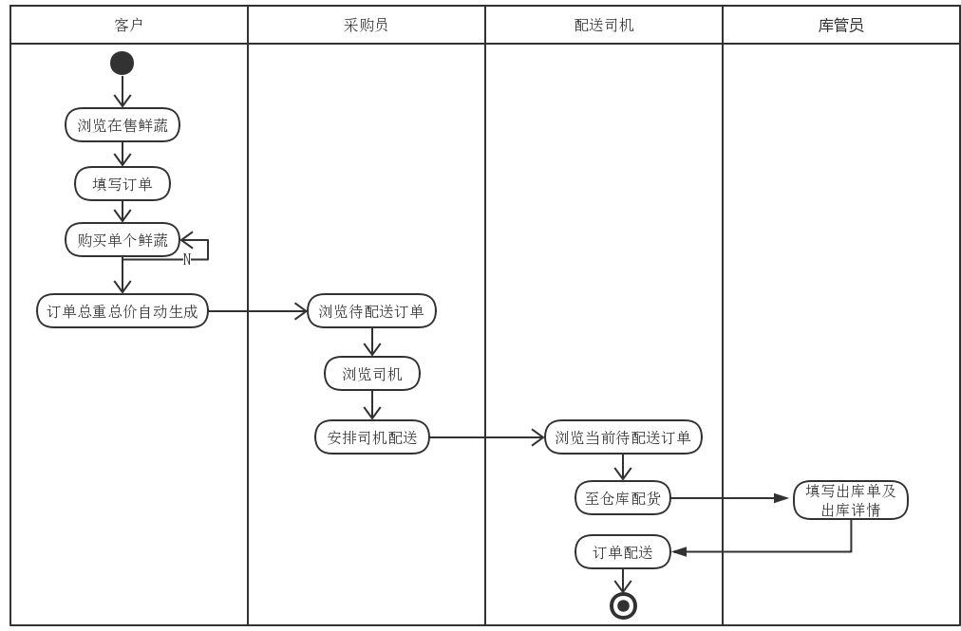
论文绪论
研究背景
研究方法
研究结果
问题讨论
论文总结
订单及配送流程

Slide 14
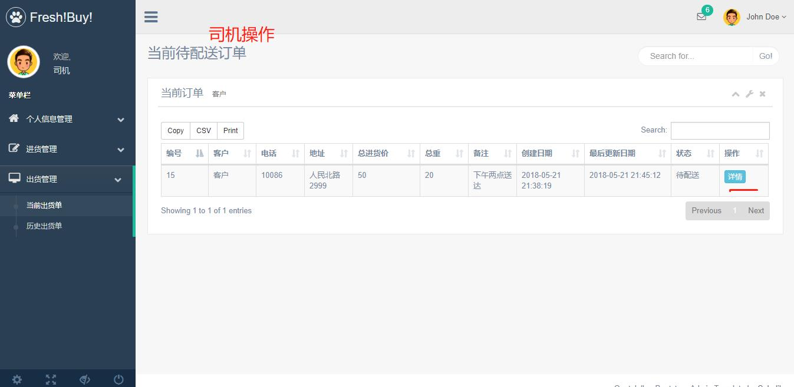
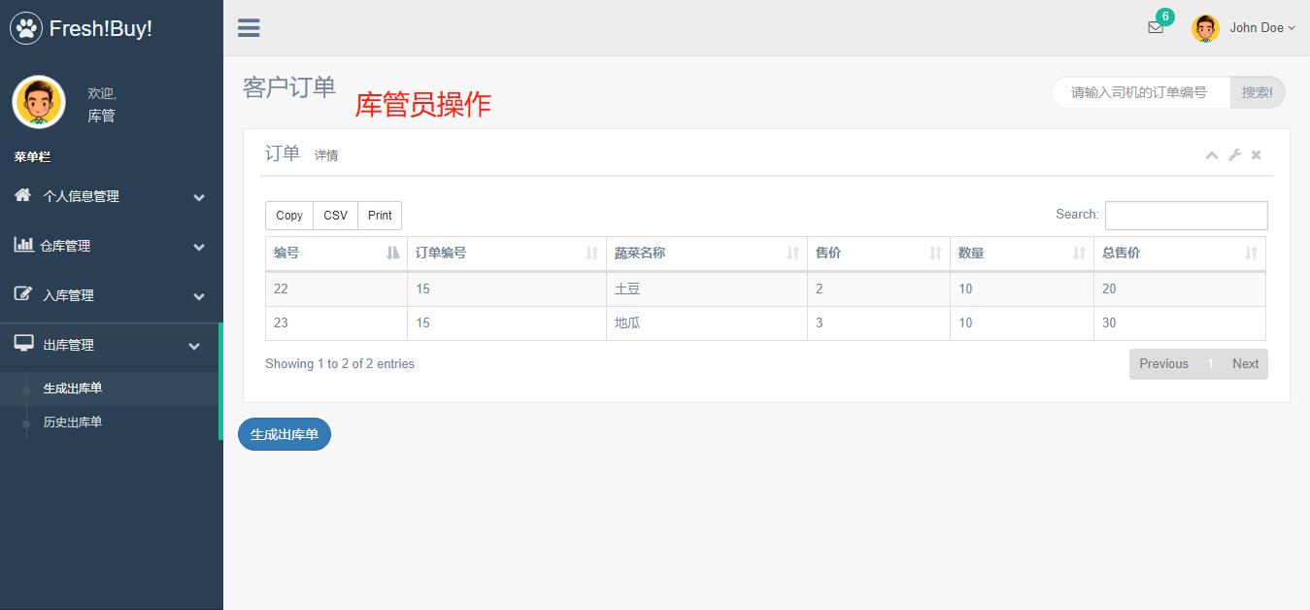
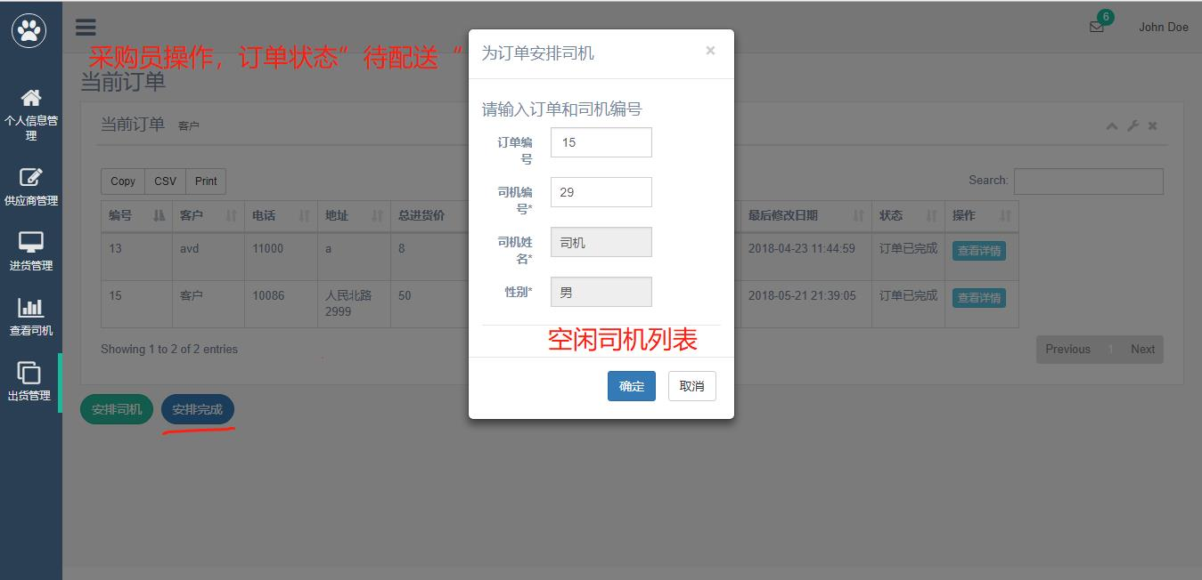
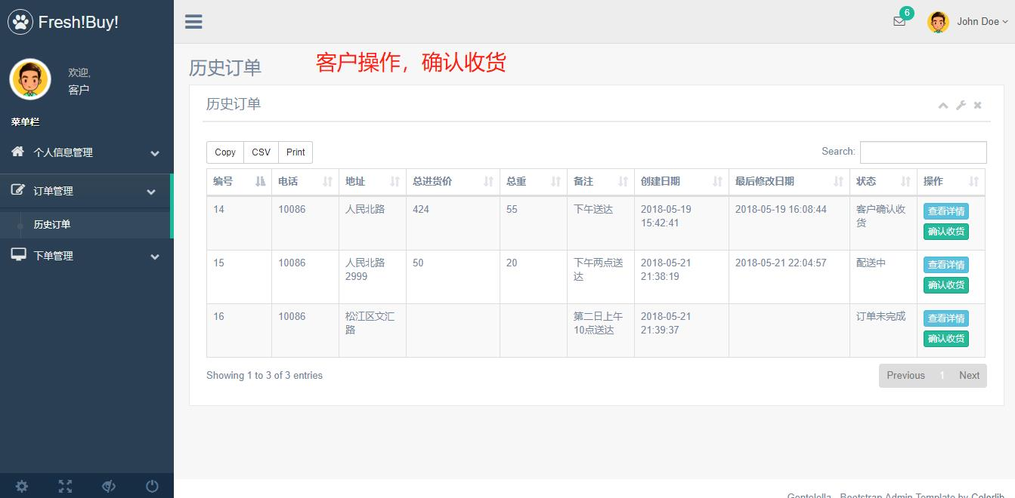
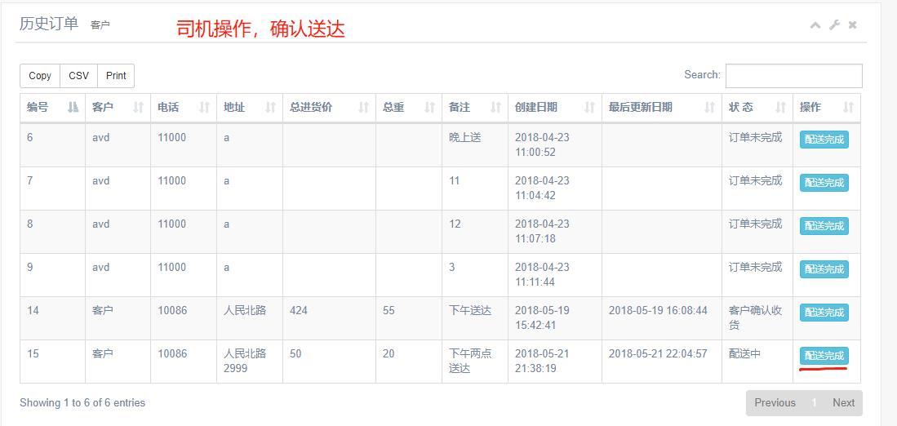
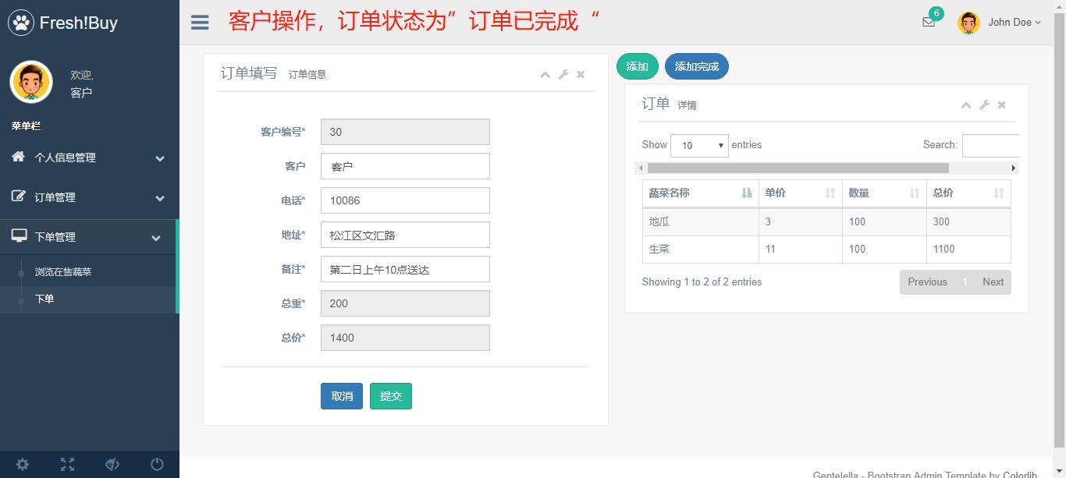
论文绪论
研究背景
研究方法
研究结果
问题讨论
论文总结
订单及配送流程

Slide 15
论文绪论
研究背景
研究方法
研究结果
问题讨论
论文总结
业务数据管理
●办公室：可以查看所有历史进货单、订单、入出库单
●客户：查看个人历史订单
●采购员：查看个人历史进货单
●库管员：查看个人所属仓库历史入库单、出库单
●司机：查看个人配送历史进货单、历史订单

Slide 16
研究意义

Slide 17
论文绪论
研究背景
研究方法
研究结果
问题讨论
论文总结
课题研究实现意义
● 解决了现有配送模式下信息化不足的弊端；
● 解决了鲜蔬不易保鲜造成的数据不对等；
● 将业务流程及数据的管理提升到直观的空间管理和网络管理；
● 数据周密准确，多处需要输入数据的地方都做了与数据库的校验。

Slide 18
论文绪论
研究背景
研究方法
研究结果
问题讨论
论文总结
ADD TITLE
ADD TITLE
It was the best of times, it was the worst of times; it was the age of wisdom, it was the age of foolishness.
It was the best of times, it was the worst of times; it was the age of wisdom, it was the age of foolishness.
ADD TITLE
ADD TITLE
It was the best of times, it was the worst of times; it was the age of wisdom, it was the age of foolishness.
It was the best of times, it was the worst of times; it was the age of wisdom, it was the age of foolishness.

Slide 19
研究结果
It was the best of times, it was the worst of times; it was the age of wisdom, it was the age of foolishness.

Slide 20
论文绪论
研究背景
研究方法
研究结果
问题讨论
论文总结
项目展望与前景
本文介绍了一个具有商业应用价值的鲜蔬配送管理系统，通过该系统充分实现了对鲜蔬配送的信息化管理，具有较好的应用前景。
对支持多重经营模式系统还未能实现，如：到点自取、按时达、立即送、周期购、预售等多重销售模式。
●
分析各供应商报价信息，多种供应商报价一体化展示及自动选择合适报价者省去审查麻烦。
●

Slide 21
论文绪论
研究背景
研究方法
研究结果
问题讨论
论文总结
TEXT
TEXT
TEXT
It was the best of times, it was the worst of times; it was the age of wisdom, it was the age of foolishness. It was the epoch of belief, and it was the epoch of incredulity. It was the season of light, and it was the season of darkness. It was the spring of hope, and it was the winter of despair.
毕业论文题目

Slide 22
论文绪论
研究背景
研究方法
研究结果
问题讨论
论文总结
It was the best of times, it was the worst of times; it was the age of wisdom, it was the age of foolishness.

Slide 23
问题讨论
It was the best of times, it was the worst of times; it was the age of wisdom, it was the age of foolishness.

Slide 24
论文绪论
研究背景
研究方法
研究结果
问题讨论
论文总结
ADD TITLE
ADD TITLE
It was the best of times, it was the worst of times; it was the age of wisdom, it was the age of foolishness.
s
It was the best of times, it was the worst of times; it was the age of wisdom, it was the age of foolishness.
T
TEXT
w
o
ADD TITLE
ADD TITLE
It was the best of times, it was the worst of times; it was the age of wisdom, it was the age of foolishness.
It was the best of times, it was the worst of times; it was the age of wisdom, it was the age of foolishness.

Slide 25
论文绪论
研究背景
研究方法
研究结果
问题讨论
论文总结
ADD YOUR TITLE
1
It was the best of times, it was the worst of times; it was the age of wisdom, it was the age of foolishness. It was the epoch of belief, and it was the epoch of incredulity. It was the season of light, and it was the season of darkness. It was the spring of hope, and it was the winter of despair.
TEXT
ADD YOUR TITLE
It was the best of times, it was the worst of times; it was the age of wisdom, it was the age of foolishness. It was the epoch of belief, and it was the epoch of incredulity. It was the season of light, and it was the season of darkness. It was the spring of hope, and it was the winter of despair.
2
3
ADD YOUR TITLE
It was the best of times, it was the worst of times; it was the age of wisdom, it was the age of foolishness. It was the epoch of belief, and it was the epoch of incredulity. It was the season of light, and it was the season of darkness. It was the spring of hope, and it was the winter of despair.

Slide 26
论文总结
It was the best of times, it was the worst of times; it was the age of wisdom, it was the age of foolishness.

Slide 27
论文绪论
研究背景
研究方法
研究结果
问题讨论
论文总结
论文总结
本文在传统行业模式下提出了创新，针对鲜蔬特性设计并实现了一套鲜蔬配送管理系统。该系统实现了完整的鲜蔬产品供应链、客户、配送和库存管理体系，将员工管理和合作客户高度信息化集成，实现配送公司专业化运作。
在以后的学习生活中，还需多积累实际经验，将该系统的不足之处及时弥补。

Slide 28
谢谢观看
姓名
孙芸芸

Slide 29
清风素材
https://12sc.taobao.com/ 整理发布

